Slide 1
University Name
GLOVE DESIGN
October 2018

Slide 2
Title
Names

Slide 3
Team Members

Slide 4
Agenda
To design a glove that fills most gaps that have been left out by the ordinary one, such as cerebral palsy situations.

Slide 5
Introduction
Glove – gripping
Ordinary glove – wide gaps
Challenges – cerebral palsy
Focus – available research and designs

Slide 6
Problem Statement
There is a wide gap that the ordinary glove has left over industries and this has been a huge detriment. The focus of our research is to design a glove that fills most gaps that have been left out, such as cerebral palsy situations.

Slide 7
Design Constraints
Pneumatic – expensive
Cost of cables
Availability
Difficulties when patients lack both hands

Slide 8
Objectives:
To come up with a glove that is more flexible and accommodates all
Improve on the existing glove technology

Slide 9
Functional Decomposition
Silicon - Our glove will be designed by solid works.
we consider individual control as opposed to linear actuators. One way to measure the ability of the patient to grip is using electromyography (EMG) which measures the potential of the muscle cells on the forearm near the wrist. Using this primary merit of the design, the ability to monitor electrical signals from patient’s brain to the forearm is pursued.

Slide 10
Literature and Patent Review
Power Glover report
We learn many things about how the power of Glover could help the people who are not able to move their hand. We learn by riding some artic and watching some videos. There are a lot of countries are working in this project like South Korea, Japan, Vietnam and they have been improving every year. There are many ways of how the glover can work is by electric, controlled by non-gripping hand and touch sensor. Each way could take long time to produce the power glove.

Slide 11
What We Didn’t Find
A major area of concern or question that erupted was in the event where both hands are amputated. What should the design look, how should it be customized to address that problem. Robots cannot effective act in the place of a human mind and that is why there is the need for an advanced glove.

Slide 12
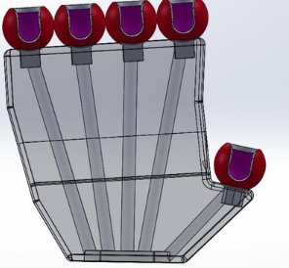
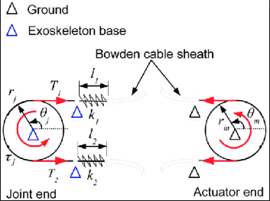
Design Ideas

Slide 13
Risk Assessment
Sustainability of our prompt – who invest on it?
Initial capital to set thing up
Availability of the resources

Slide 14
Summary
Linear actuators, pumps, compressors and servomotors are some of the methods used for generating gripping force required for objects not forgetting the transmission force method is the major determinant of the method of force generation. Hollow cables or coatings surrounding cables can also be used to transmit the forces of pushing and pulling which are the most suitable solution to this problem taking available resources into consideration.

Slide 15
Questions?
A major area of concern or question that erupted was in the event where both hands are amputated? What should the design look like? and how should it be customized to address that problem?

